Slide 1
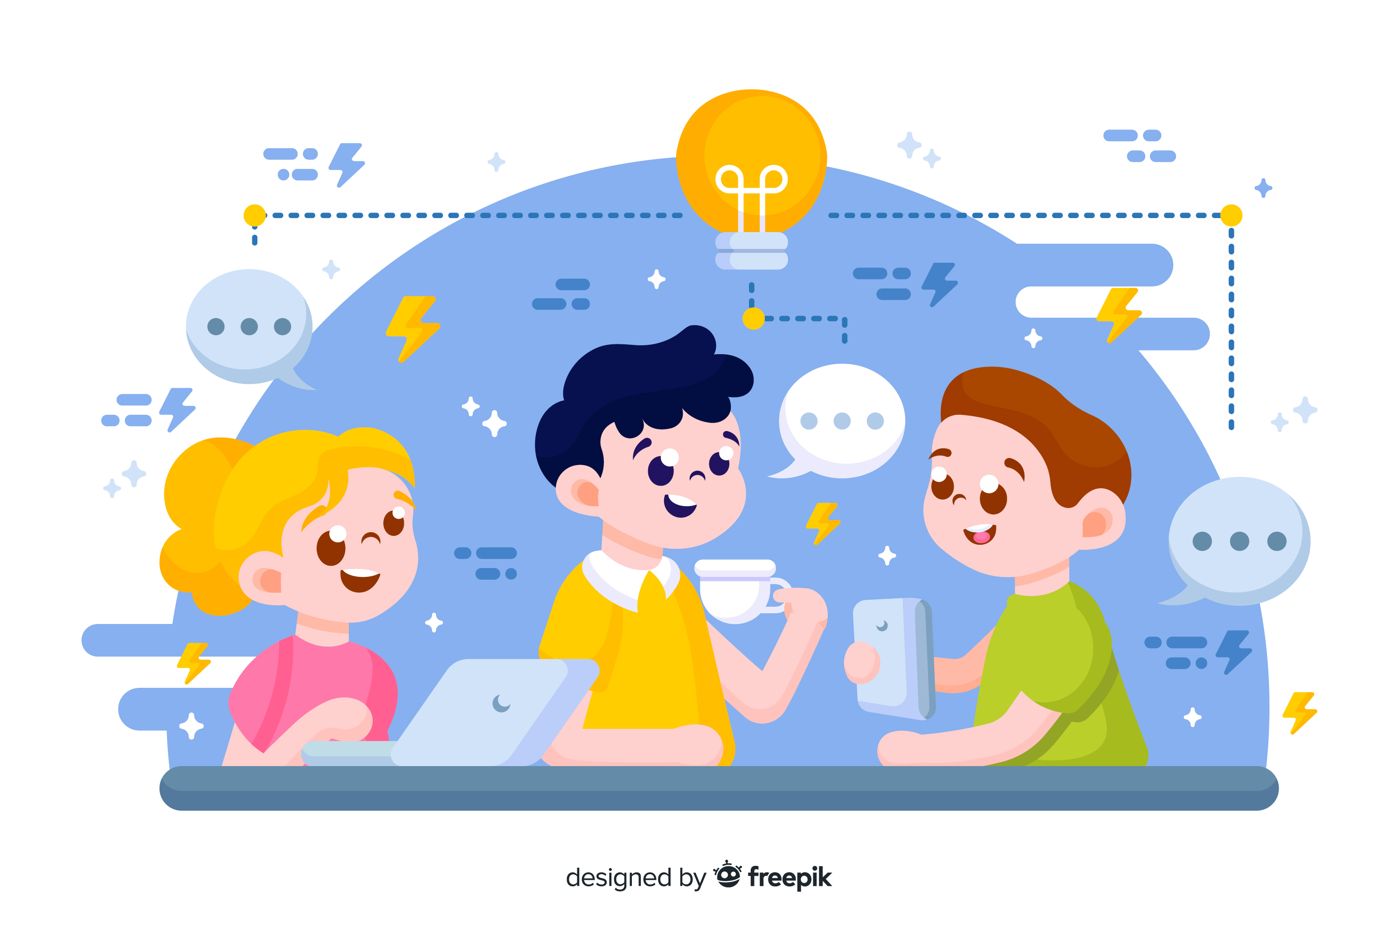
Learn Programming For Kids (Python)

Slide 2
Lesson 10
Fun Activities – Python Projects for Kids

Slide 3
13. Python Projects for Kids
To make learning Python more exciting, here are a few project ideas for kids:

Slide 4
Project 1. Simple Calculator

Slide 5
Project Description:
Create a simple calculator which can perform basic arithmetic operations like addition, subtraction, multiplication, or division depending upon the user input. Approach :
User chooses the desired operation. Options 1, 2, 3, and 4 are valid.
Two numbers are taken and an if…elif…else branching is used to execute a particular section.
Using functions add(), subtract(), multiply() and divide() evaluate respective operations.

Slide 6
Project 2. Guess the Number

Slide 7
Project Description:
This project involves generating a random number and letting the user guess it.
It generates a random number.
Allows the user to guess a number.
If the guessed input number is smaller than the generated number, a message "Too low!" is printed. If it is larger, it prints the message "Too high!" Until you enter the correct number

Slide 8
Project 3. Simple To-Do List

Slide 9
Project Description:
This project introduces basic list manipulation. Children can add, remove, and display items in a to-do list.

Slide 10
Project 4. Mad Libs Game

Slide 11
Project Description:
This project combines basic string manipulation with user input. Children fill in the blanks of a story with their own words.

Slide 12
Project 5. Hangman Game

Slide 13
Project Description:
This project introduces string manipulation and loops. Children guess letters to uncover a hidden word.

Slide 14
Project 6. Simple Drawing Program

Slide 15
Project Description:
This project introduces basic graphical user interface (GUI) concepts using the ‘turtle’ module. Children can draw shapes and patterns.

